Slide 1

Smart Attendance Monitoring System
Devang Dhuri-(22106036)
Krishna Dongre-(22106089)
Sumedh Gadpayle-(22106076)
Project Guide-
Prof. Snehal Kangane
Notes:
1

Slide 2
Introduction
The Attendance Management System is a digital solution designed for college faculty to streamline student attendance tracking. Traditional roll calls are time-consuming and prone to errors, making record-keeping inefficient. This system provides a user-friendly interface for faculty to log in, select subjects, manage student details, and mark attendance seamlessly. It reduces administrative workload, enhances accuracy, and ensures efficient data management. Faculty can also update student records and generate reports for better decision-making. By automating the process, the system improves productivity and helps maintain reliable attendance records.
Notes:
2

Slide 3
Objectives
The Smart Attendance Monitoring System (SAMS) aims to:
Provide real-time visual analytics for student attendance trends.
Ensure high accuracy and eliminate proxy attendance.
Improve administrative efficiency by integrating with existing databases.
Generate insightful reports for decision-making.
Ensure data security and compliance with privacy regulations

Slide 4
Outline
Introduction
Literature Survey of the Existing Systems
Limitations of the Existing Systems
Problem Statement
Proposed System Design
Framework/Algorithm
Technologies Stack for Proposed System
Implementation(Partial)
Conclusion
References

Slide 5
Literature Survey
Sr.No | Title | Author | Description
[1] | Android based smart learning and attendance management system.June, 2015[1] | Rakhi Joshi1 , V. V. Shete2 , S. B. Somani3 | Technology has modernized India's education with smart classes and video conferencing. This research proposes an Android attendance app with study materials, notices, exam reminders, and performance tracking. Teachers mark attendance via smartphones, and students get SMS alerts for low attendance.
Notes:
5

Slide 6
Literature Survey
Sr.No | Title | Author | Description
[2] | Student Attendance System Using An Android Based Mobile Application.April 2021 | Alif Fatihi Abdul Fatah2 , Roslina Mohamad*1,2, Farah Yasmin Abdul Rahman2 , Nur'ain Izzati Shuhaimi1,2 | The rise of IoT has created a need to replace traditional paper-based attendance in universities. An Android-based mobile application was developed to record attendance efficiently, storing student data in a database. The system provides an intuitive interface for lecturers and administrators to manage records easily.

Slide 7
Literature Survey
Sr.No | Title | Author | Description
[3] | Real-time Student Management Application Using Google Firebase and Android Studio.June 2021 | Ravi Sharma; Taufique Umar Bux; Bhavya Varshney; Kartikeya Tomar | This paper proposes an RFID-based attendance system using Google Firebase and the NodeMCU ESP8266 Wi-Fi module. It automates attendance recording, ensures secure storage, enhances data analysis, and enables mobile access via an Android app.

Slide 8
Literature Survey
Sr.No | Title | Author | Description
[4] | Student Attendance Management System Based on Fingerprint Identification Technolog. November 2023 | Yi Yi | This paper explores the design and implementation of a fingerprint-based student attendance system to improve efficiency and accuracy. It analyzes design principles, system structure, and fingerprint recognition integration. Results show the system enhances convenience, speed, and standardization over traditional methods, boosting university learning efficiency.

Slide 9
Limitations of Existing Systems
Manual Entry: Requires teachers to mark attendance manually.
Limited Automation: No biometric or RFID integration.
User-Dependent Accuracy: Accuracy depends on the teacher's input.
Basic Features: Allows login, subject selection, student list, attendance marking, and student info editing.
Notes:
9

Slide 10
Problem statement
The traditional attendance management system relies on manual methods, such as paper-based records or roll calls, which are time-consuming, error-prone, and inefficient. These methods can lead to data loss, manipulation, and difficulty in tracking student performance. An automated attendance system using modern technology, such as mobile applications, ensures accuracy, security, and real-time data access. This solution enhances efficiency, reduces administrative workload, and improves overall attendance tracking.

Slide 11
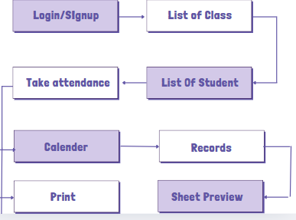
Proposed System Design
Notes:
11

Slide 12
Technology Stack for Proposed System
Java for functions
XML for layouts
SqLite for database
Gradle for runtime environment
Notes:
12

Slide 13
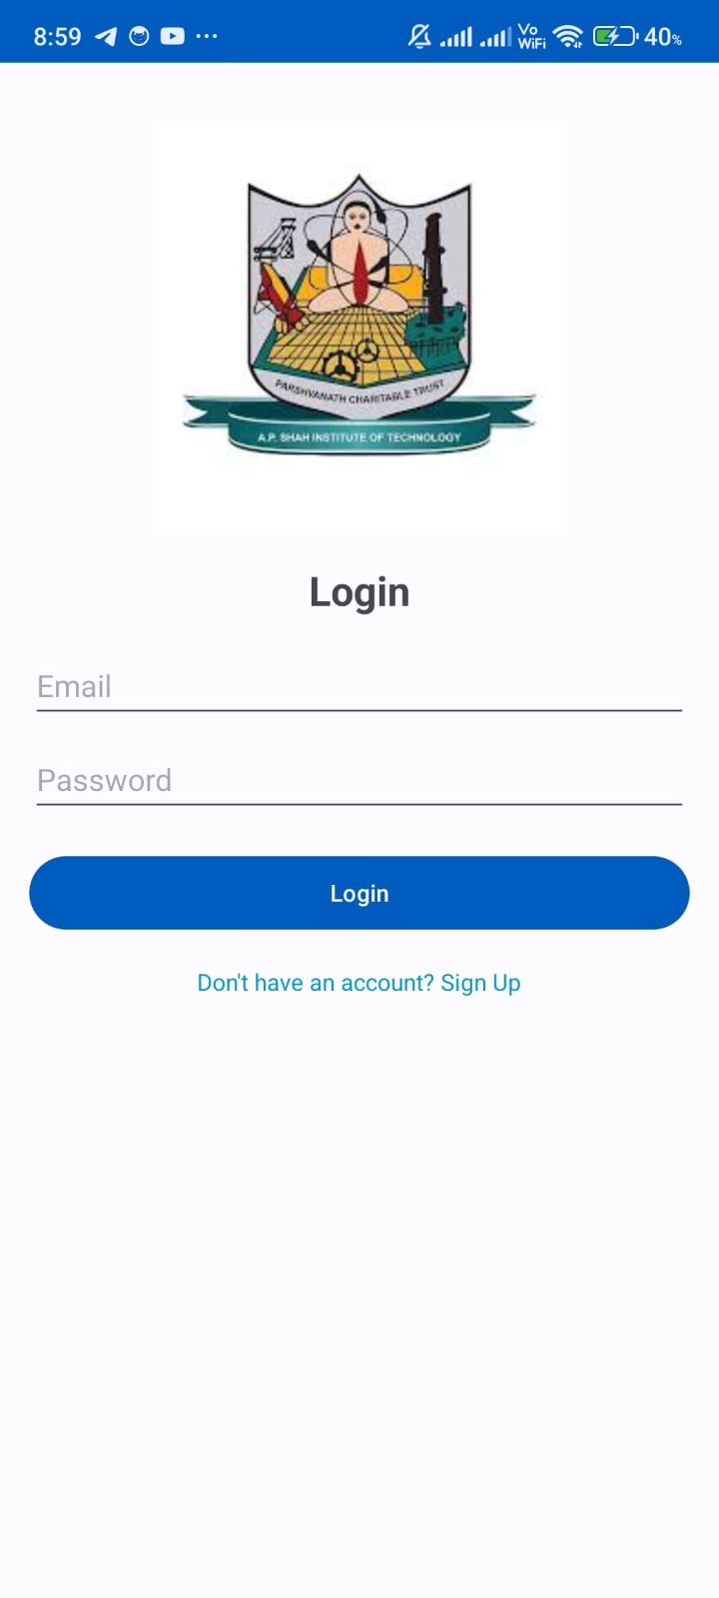
Implementation
Notes:
13

Slide 14
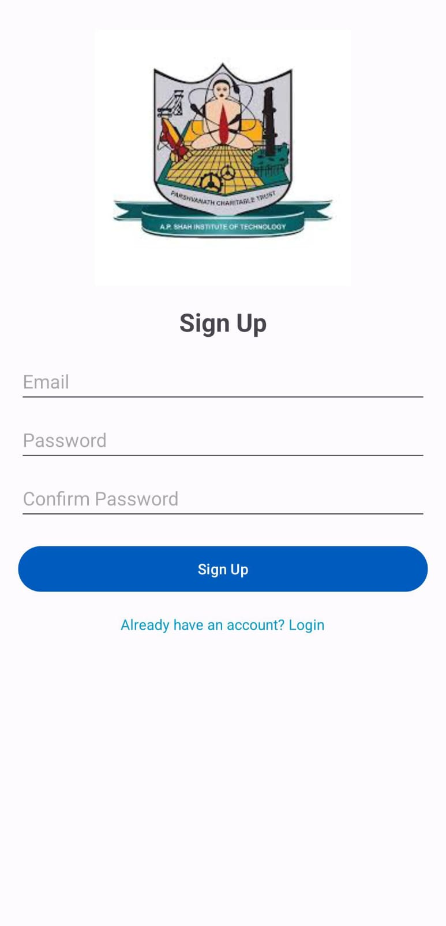
Implementation
Notes:
14

Slide 15
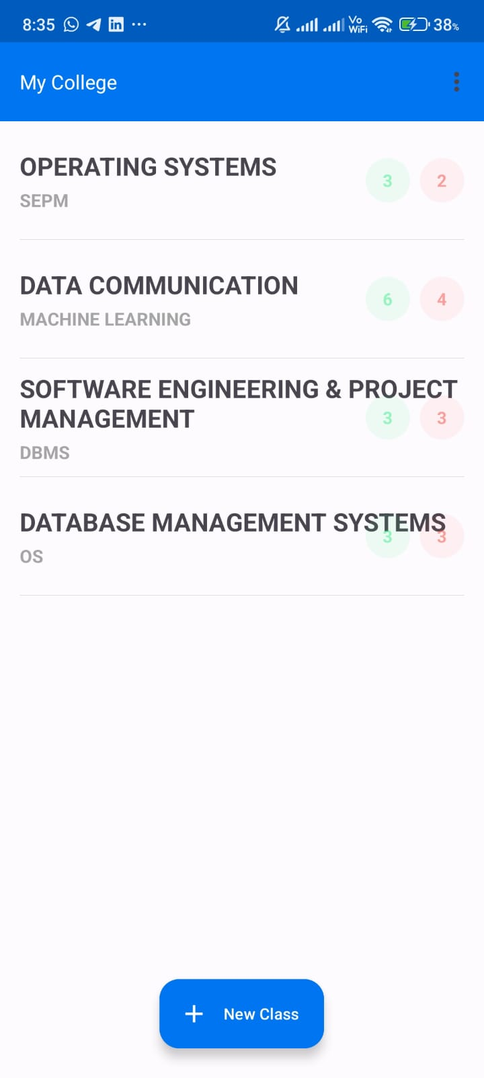
Implementation
Notes:
15

Slide 16
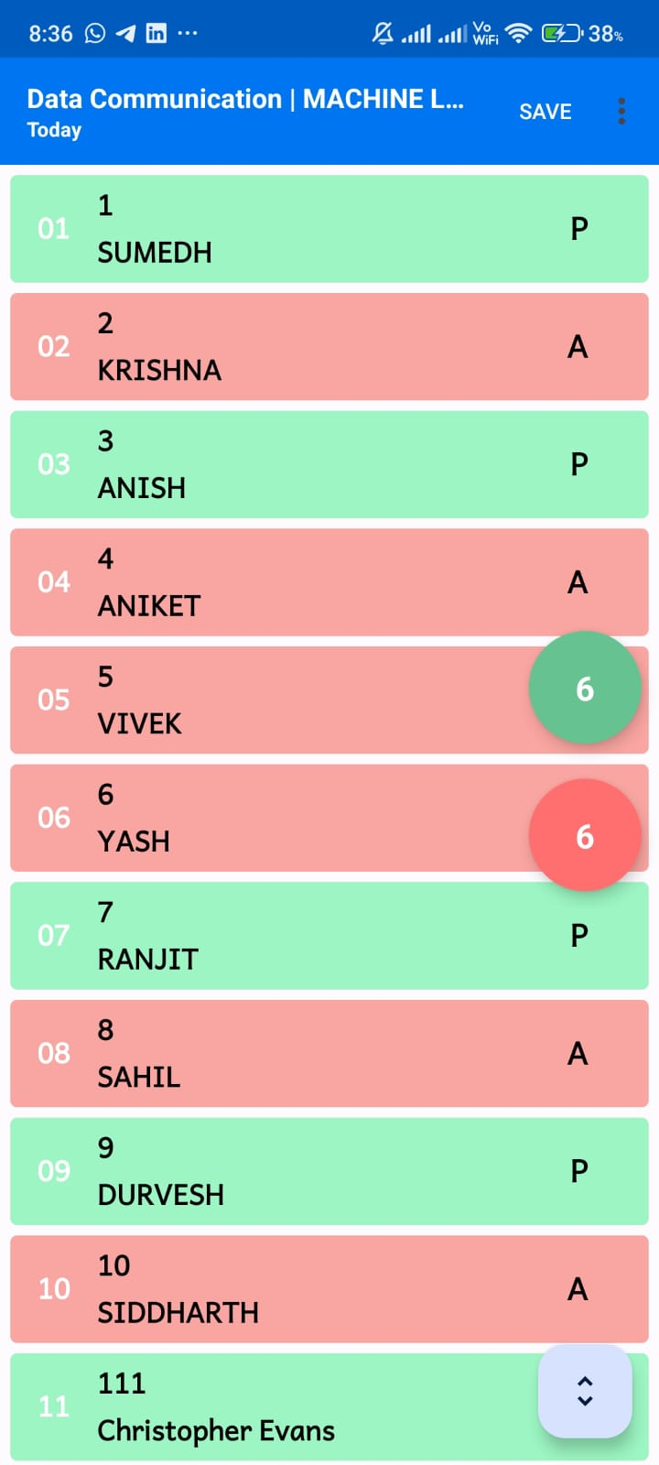
Implementation
Notes:
16

Slide 17
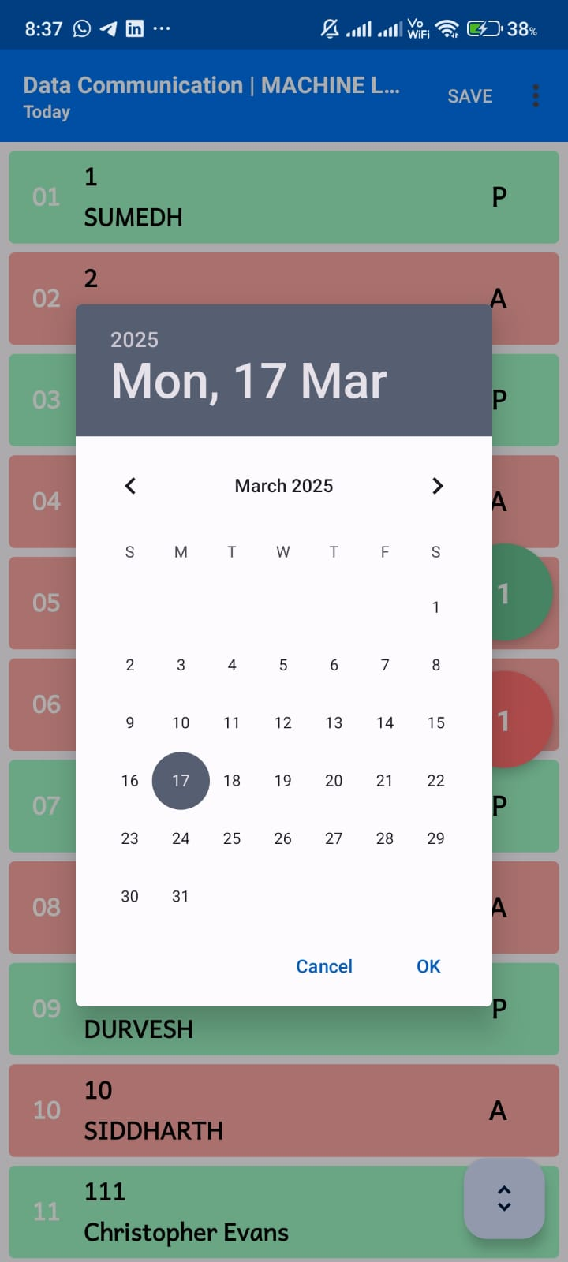
Implementation
Notes:
17

Slide 18
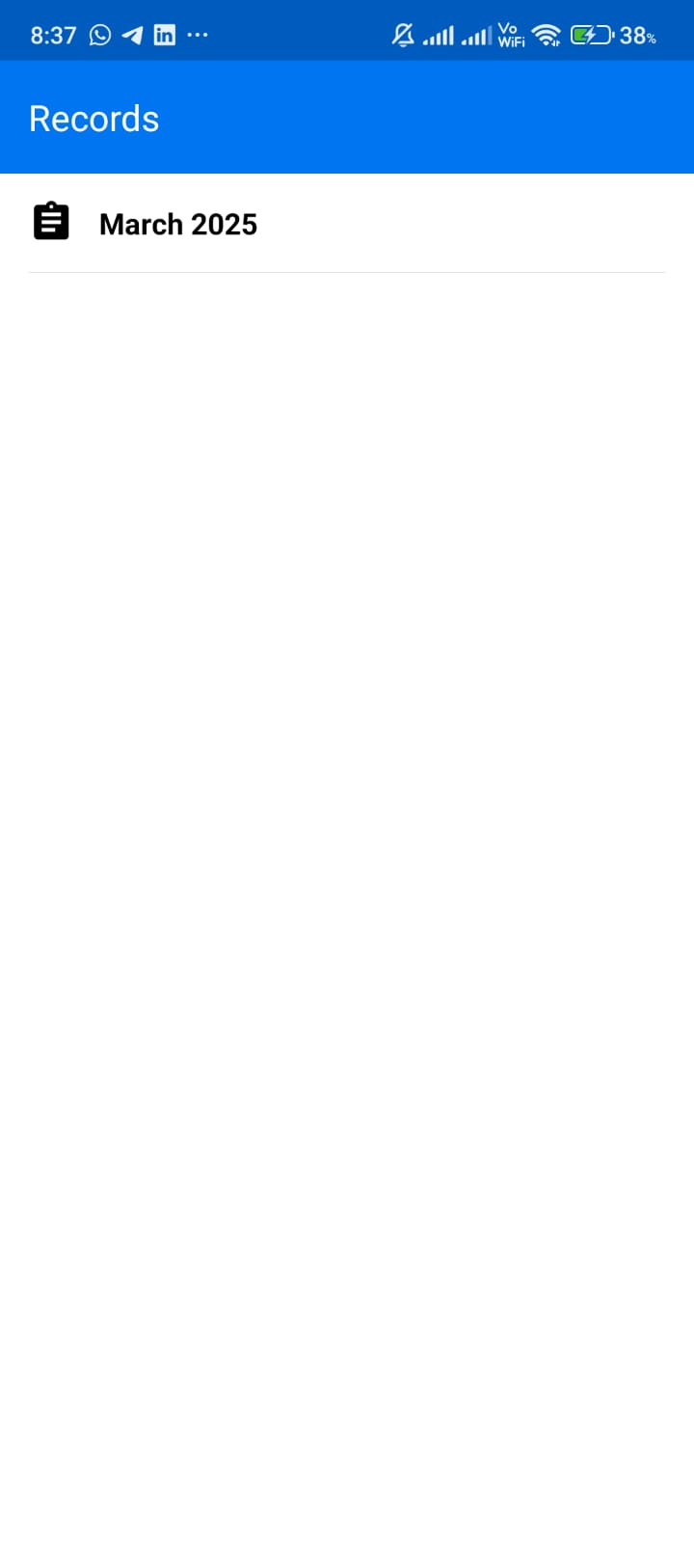
Implementation
Notes:
18

Slide 19
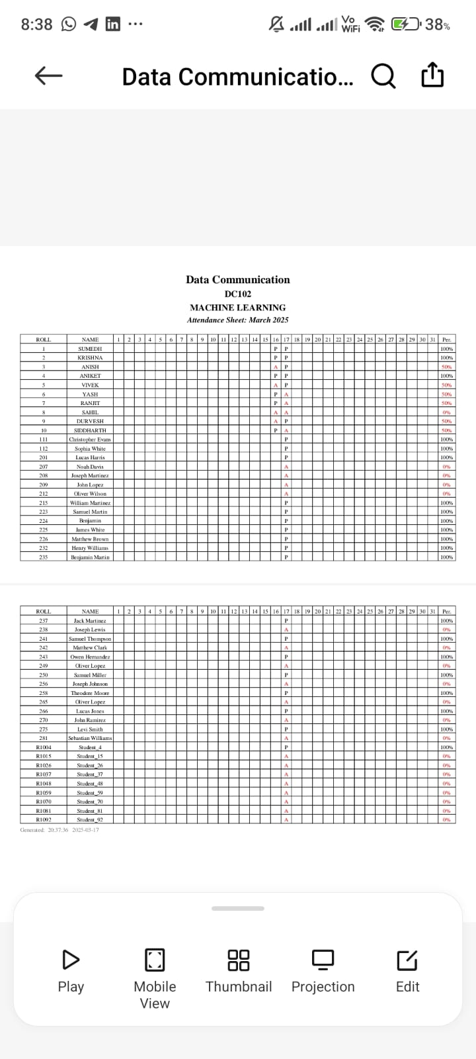
Implementation
Notes:
19

Slide 20
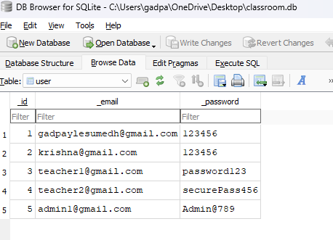
Implementation
Notes:
20

Slide 21
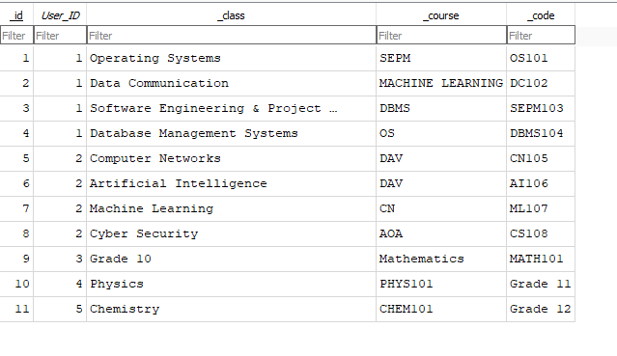
Implementation
Notes:
21

Slide 22
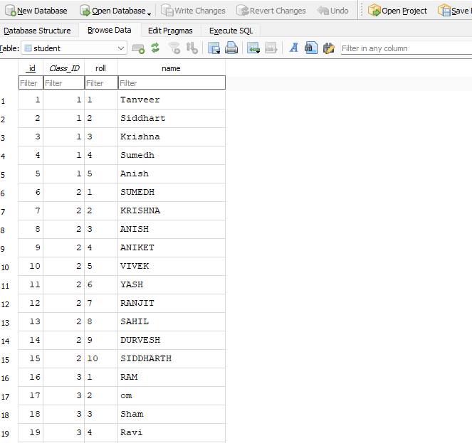
Implementation
Notes:
22

Slide 23
Conclusion
The Smart Attendance Management System with Visual Insights revolutionizes traditional attendance tracking by leveraging AI, biometrics, and real-time data analytics. It enhances accuracy, efficiency, and security, reducing manual errors and fraudulent practices like proxy attendance. With cloud integration, real-time monitoring, and predictive analytics, organizations can make data-driven decisions to improve engagement, compliance, and resource management.
Notes:
23

Slide 24
References
Joshi, R., Shete, V. V., & Somani, S. B. (2015). Android based smart learning and attendance management system. International Journal of Advanced Research in Computer and Communication Engineering, 4(6), 256-260. [1]
A. F. Abdul Fatah, R. Mohamad, F. Y. Abdul Rahman and N. I. Shuhaimi, "Student Attendance System Using An Android Based Mobile Application," 2021 IEEE 11th IEEE Symposium on Computer Applications & Industrial Electronics (ISCAIE), Penang, Malaysia, 2021, pp. 224-227, doi: 10.1109/ISCAIE51753.2021.9431771. [2]
R. Sharma, T. U. Bux, B. Varshney and K. Tomar, "Real-time Student Management Application Using Google Firebase and Android Studio," 2021 International Conference on Intelligent Technologies (CONIT), Hubli, India, 2021, pp. 1-6, doi: 10.1109/CONIT51480.2021.9498494. [3]
Student Attendance Management System Based on Fingerprint Identification Technology. Yi Yi,November2023.[4]
Notes:
24

Slide 25
Thank You...!!
Notes:
25

